Slide 1
Module A – Background and Responses to Sexual Abuse
Primarily for Seminaries and Also Parts for Parishes and Dioceses

Slide 2
Background and Responses to Sexual Abuse of Minors by Catholic Priests in the United States

Slide 3
Main Sources of Data
Reports presented to the United States Conference of Catholic Bishops by the John Jay College Research Team, The City University of New York*
The Causes and Context of Sexual Abuse of Minors by Catholic Priests in the United States, 1950-2010, March, 2011
The Nature and Scope of Sexual Abuse of Minors by Catholic Priests and Deacons in the United States, 1950-2002, February 2004
* The two reports are based on data supplied by 97 percent of U.S. archdioceses and dioceses on all clergy accused of sexual abuse of minors

Slide 4
Causes and Context - Methodology
Analysis of clinical data from the files from three treatment centers, including information about priests who abused minors as well as those being treated for other behavioral problems (individual/psychological analysis)
Analysis of seminary attendance, history and the development of a human formation curriculum, as well as information from seminary leaders (seminary analysis)

Slide 5
Methodology, 2
Interview and primary data from the 1971 Loyola University study of the psychology of American Catholic priests (baseline study of priests at the peak of the abuse crisis)
Surveys of survivors, victim assistance coordinators and clinical files about the onset, persistence and desistance of abuse behavior (victim and situational analysis)

Slide 6
Methodology, 3
Surveys of bishops, priests and other diocesan leaders about the policies that were put in place after 1985 (leadership analysis)
Surveys of and interviews with inactive priests with allegations of abuse, and a comparison sample of priests in active parish ministry who had not been accused (identity and behavior survey)

Slide 7
Timeframes of First Abuse
Most priest abusers were in seminary before the 1960s, but offended after the 1960s
Among priests who engaged in abusive behavior, the more recently they were ordained the more quickly after ordination did they abuse

Slide 8
Historical Changes in Abusers
Year of % of All Average Age Average Time
Ordination Abusers at 1st Incident to 1st Abuse
1940s 40% 44 17 years
1950s 39 12 years
1960s 25% 35 8 years
1970s 20% 33 5 years
1980s 10% 35 3 years

Slide 9
The Rise and Fall of Abuse
Total credible accusations in which the date of abuse is known through 2010 is 14,041 (14,598 by 2011); (the year of abuse was unknown in 37 cases of the additional 594 in 2011).* In the 2011 report, 23 accusations of abuse happened in that year, 21 of whom were made against diocesan priests and 2 against religious priests.
Although widely believed to be a significant ongoing problem, most abuse occurred between 1960 and 1984 (74.6%) 10,886 known offenders; after that year the numbers dropped substantially and remain low
Before 1960, the proportion of credible accusations of abuse was 11.6% (1,691 known offenders)
From 1985 to 1995, the proportion of credible accusations of abuse was 10.3% (1,503 known offenders)
From 1995 to 2011, the proportion of credible accusations of abuse was 3.5% (518 known offenders)
*For 2010 and 2011, the year of abuse is unknown in 72 of the reported cases and from 2004 to 2009, the year of abuse is unknown in 256 reported cases. These are not included in the total numbers.

Slide 10
National Patterns of Social Change
During the period under study, the U. S. experienced significant and widespread social change that encompassed:
Steady increases in attitudes and behaviors associated with increased individualism between the 1960s and the 1980s – resulting in positive increases on creativity and productivity, and negative results associated with permissiveness, deviance, and harm to others
A sharp reaction in the 1980s and 1990s to increases in crime and an increased understanding of the harms of teenage parenthood, domestic violence, and abuse of children, followed by decreases in these behaviors

Slide 11
Distribution of Abuse – Incidence (Count of abuse incidents, JJC & CARA, 1950-2002, 2004-2008)

Slide 12
Priests Who Have Allegations of Sexual Abuse against Them
The majority of priests with allegations of abuse from 1950-2002 were ordained between the 1950s and 1970s
The majority of those with allegations against them are diocesan priests
Religious priests have slightly more than half as many allegations; fewer religious have multiple allegations or “severe” offenses

Slide 13
Decline in Incidence
The peak numbers of abuse cases precede the Gauthe scandal and actions by the Church; they match other indications of social stress on those in Catholic ministry, e.g., many resignations took place
The 1970s is the decade of greatest incidence and also the decade of universal statutory change
After 1985, publicity and church action increased awareness and numbers decline rapidly
The influence of statutory change is difficult to disaggregate from social forces and growing public understanding of domestic abuse.

Slide 14
Mainstream Seminary Formation
Major Seminary Education
Diocesan priests who would later abuse were trained predominantly in major U.S. theological seminaries
Almost all major seminaries graduated priests who would later abuse minors, but the numbers varied significantly from one seminary to another
Minor Seminaries
Priests who began in minor seminary are not more likely to later abuse
Seminary Program Changes
Administrators and faculty evaluated seminary education over this period of time (1980s to the present) and introduced significant changes in programs of human formation

Slide 15
Sexual Abuse and Civil Authorities
Until recently few incidents of abuse by priests were reported to the police
Only one-third of those priests who were reported to the police were charged with a crime because many cases were made known decades later
Only 3% of all priests with allegations served prison sentences and prosecution was not possible since the statute of limitations had expired

Slide 16
National Patterns of Accusations: Extent of the Problem
Most accusations of priests abusing children were unknown to civil authorities before 2002; one-third of all accusations were reported to church authorities in 2002
Between 1950 and 1985, the total number of incidents of sexual abuse of children reported to Catholic dioceses was 810
The total reported (by 2010) to have occurred between 1950 and 1985 exceeds 11,000 (11,719)

Slide 17
Reports and Response, mid-1990s
Total Reports, 1990 to 1998 = 3,754
Almost all dioceses received reports in this period
- 75% of incidents were reported by victim or attorney
- 60% were reported to diocese, 9% by legal filing
- 9% were reported within two years of the incident, or less
- 50% reported 20 years or more after the incident
Reports of abuse are now being made by adults many of whom are represented by lawyers and who are reporting abuse that took place many years earlier.

Slide 18
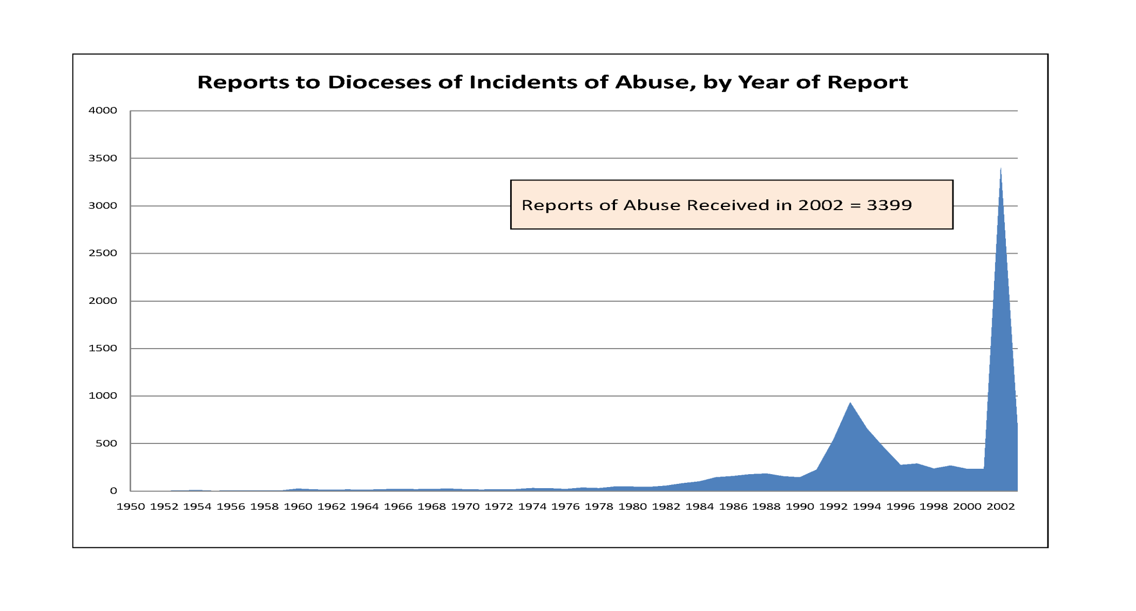
Nature and Scope: Reports of Abuse, by Year Reported

Slide 19
Development of the Five Principles
1985 – 1995: The issue of sexual abuse is discussed annually at meetings of the bishops; expert presentations given
Leadership from Cardinal Bernardin, Archdiocese of Chicago, importance of lay review boards stressed
Work of the Ad Hoc Committee resulted in publication of Restoring Trust and other changes
Use of treatment continues, with extensive communication with treatment centers (surveys of treatment centers; reports to dioceses on priests referred for treatment provided)
Growing advocacy for victims from organized groups of those who had been abused; included priests who had been abused
Most dioceses had codified the Five Principles by mid-1990s; about 50% had review boards

Slide 20
“Five Principles” Adopted by the Bishops’ Conference
“Five Principles” to Guide the Response of Bishops (1992)
(1) Respond promptly to all allegations of abuse where there is reasonable belief that abuse has occurred;
(2) If such an allegation is supported by sufficient evidence, relieve the alleged offender promptly of his ministerial duties and refer him for appropriate medical evaluation and intervention;
(3) Comply with the obligations of civil law regarding reporting of the incident and cooperating with the investigation;
(4) Reach out to the victims and their families and communicate sincere commitment to their spiritual and emotional well-being; and
(5) Within the confines of respect for privacy of the individuals involved, deal as openly as possible with the members of the community

Slide 21
Problems with the Implementation of the Five Principles, 1990 - 2002
Diocesan leaders in many instances failed to meet with victims directly
Reports from family members did not result in any follow-up from the diocese
Priests were sent for treatment, then returned to service; parishes were not notified of the history of abuse
Communication took place with civil authorities only in the most severe cases of repeated abuse
Diocesan leaders who gave testimony under oath in civil cases denied the substance of the Five Principles
Focus was on outcomes for priests, but lacked recognition of responsibility for harm to victims

Slide 22
Diocesan Practices Changed Slowly
Diocesan failures during the pre-2002 period anticipated (predicted) the confusion and lapses of the post-2002 period
Lack of full implementation of the Five Principles in the mid-1990s led to a reluctance to be transparent about the actions taken in response to reports of abuse
Lack of understanding of the timing of abuse incidents (in the 1960s and 1970s) and reports of abuse (in the 1990s) complicated diocesan explanations
Understanding of the harm of abuse has come slowly
Change in practices has come slowly; delay was pronounced in large and influential dioceses

Slide 23
Understanding of Sexual Abuse by Church Leaders
By 1985 bishops knew that sexual abuse of minors by priests was a problem, but they did not understand the scope of it nor the impact on victims; 810 cases had been reported to dioceses by 1985, so the problem did not appear to be as widespread and sizeable as it was
The vast majority of cases were reported after 1995, and a third in the year 2002 alone; only after 2002 did most bishops become fully aware of the scale and scope of the problem

Slide 24
Ongoing Concerns about Sexual Abuse
Sexual abuse is a dynamic issue, an ongoing problem; the harm of even one case is not to be underestimated
“The problem of sexual abuse has not been fixed”
Potential rise in abuse may be related to pornography, which is a potential predictor of abuse; it is done in privacy and more difficult to identify
Objectification of the person, such as use of children in pornographic materials, is not victimless

Slide 25
Summary of Background and Responses
Causes and Contexts Methodology
Timeframes and Historical Changes in Abuse
Seminary Formation
Reports and Response to Sexual Abuse
Development and Implementation of
“The Five Principles”
Understanding of Abuse by Church Leaders

Slide 26
Discussion Questions
What reflections do you have on your own experience of this time period?
What lessons can be learned from the changes in patterns of abuse over time?
How can the implementation of “The Five Principles” by dioceses be improved?
What are some of the major concerns about the understanding of sexual abuse?
How can the response by those who must be accountable for preventing sexual abuse be improved?
Link to USCCB – http://www.usccb.org/issues-and-action/child-and-youth-protection/charter.cfm

Slide 27
Prepared by:
Sister Katarina Schuth, O.S.F., St. Paul Seminary School of Divinity, University of St. Thomas
Technical Associate: Catherine Slight
Consultants:
Dr. Karen Terry and Margaret Smith, John Jay College of Criminal Justice, authors of major studies on sexual abuse for the USCCB;
Dr. Mary Gautier, Center for Applied Research in the Apostolate
A-27

